Slide 1
CEO Turnovers and Disruptions in Customer–Supplier Relationships
Vincent J. Intintoli, Matthew Serfling, and Sarah Shaikh (2017)
Presented by Nicholas Thompson

Slide 2
Research Question
Does the replacement of a customer firm’s CEO affect its relationships with dependent suppliers?

Slide 3
Prior Literature
Dependent suppliers benefit from operational efficiencies (Kalwani & Narayandas, 1995; Patatoukas, 2012; Cen et al., 2016) but face risks due to limited diversification and relationship-specific investments.
New CEOs often drive strategic and operational changes (Denis & Denis, 1995; Huson et al., 2004), impacting supplier sales and profitability.
Disruptive events can trigger negative stock reactions for suppliers (Hertzel et al., 2008; Kolay et al., 2016), reflecting heightened risks.

Slide 4
Hypothesis
The replacement of a customer’s CEO disrupts its relationships with dependent suppliers.

Slide 5
Data
Compustat Segment Files: Identified U.S.-based suppliers reporting significant customers (≥10% of revenue) from 1993–2011; includes voluntarily reported customers <10%.
ExecuComp: Matched customer-firm CEO data to segment files (47.1% match rate).
Compustat Annual Files: Financial statement data.
CRSP: Stock return data.
Thomson Reuters Insider Filing Data Feed: Blockholder data.
Sample: 5,876 customer–supplier pairs, with 2,586 experiencing a CEO turnover (treatment group) and 3,290 without a turnover (control group).

Slide 6
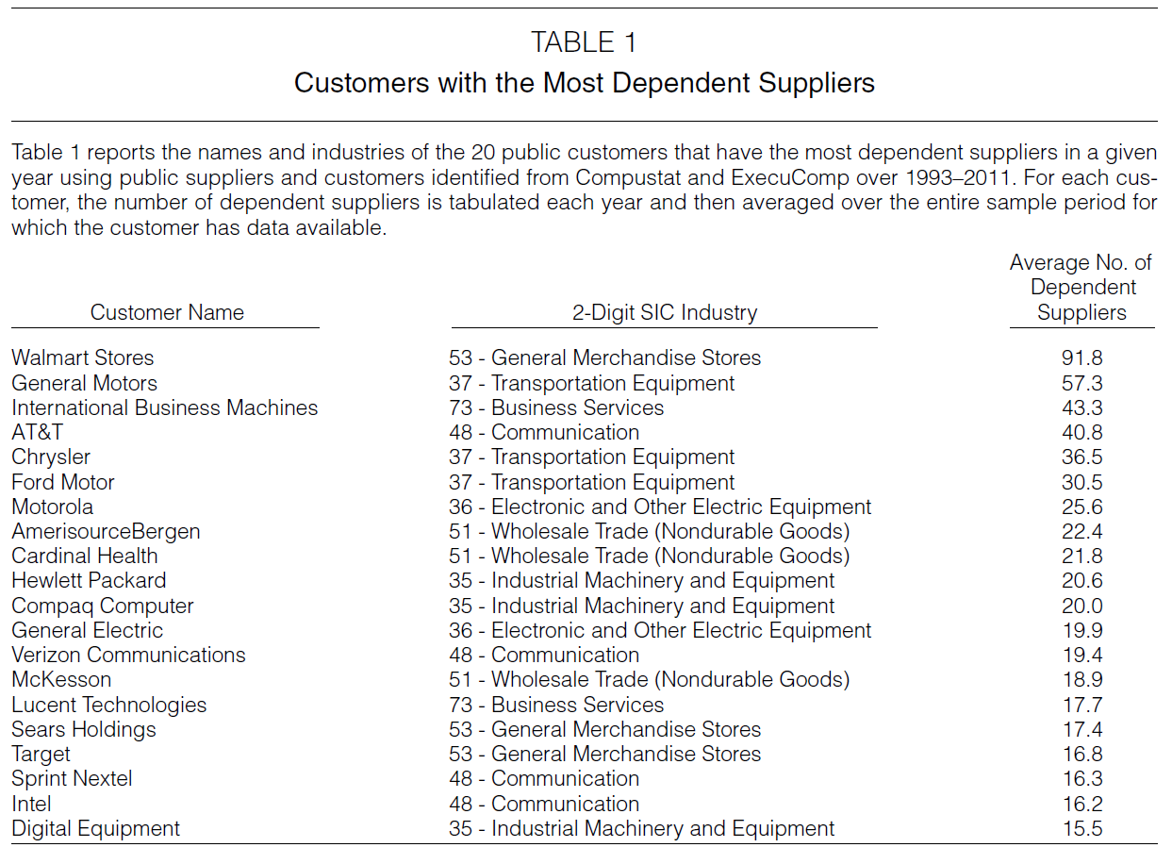
Notes:
In general, large firms selling to end consumers comprise this list.

Slide 7
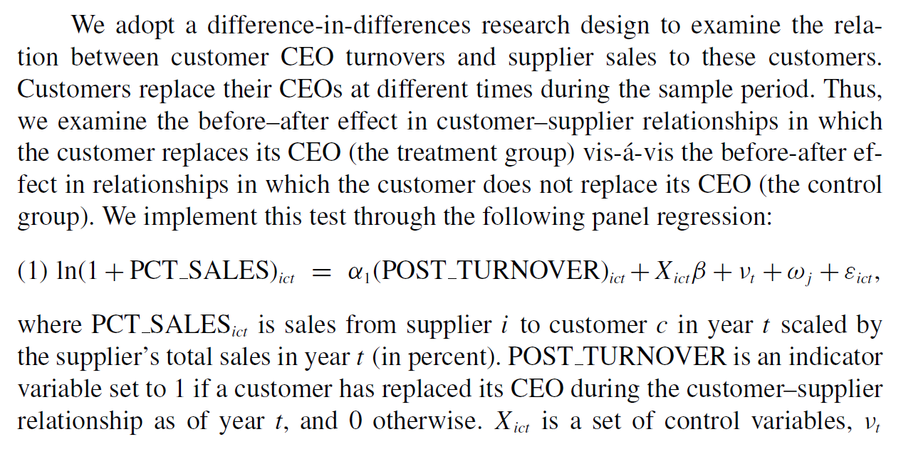

Slide 8

Notes:
Although suppliers often report customers that account for less than 10% of their total sales, accounting and security regulations require suppliers to report only customers that account for at least 10% of total sales.
The pattern evident in both graphs suggests that a nontrivial number of suppliers choose not to report sales to a customer when sales account for less than 10% of revenues.

Slide 9
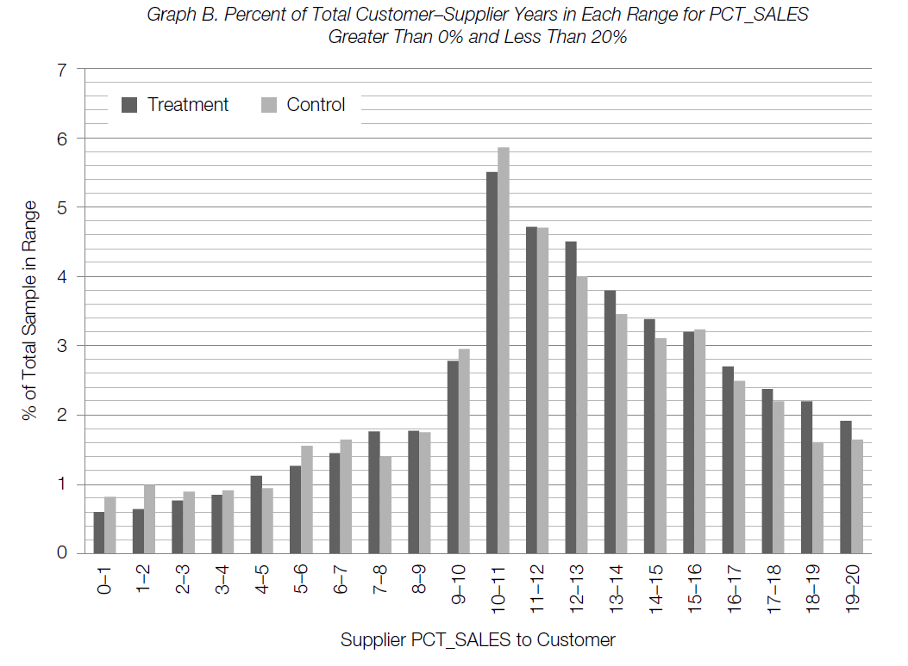

Slide 10
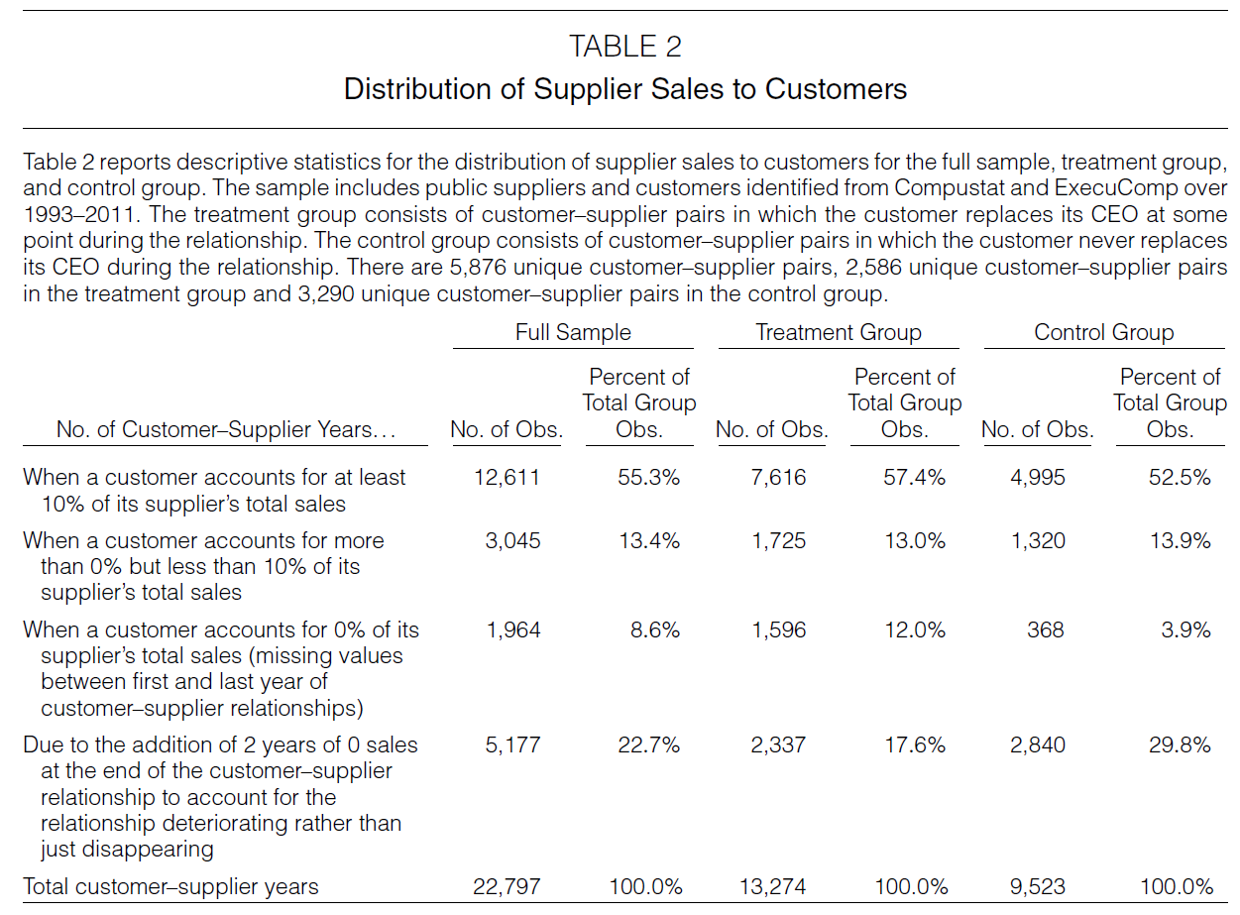

Slide 11
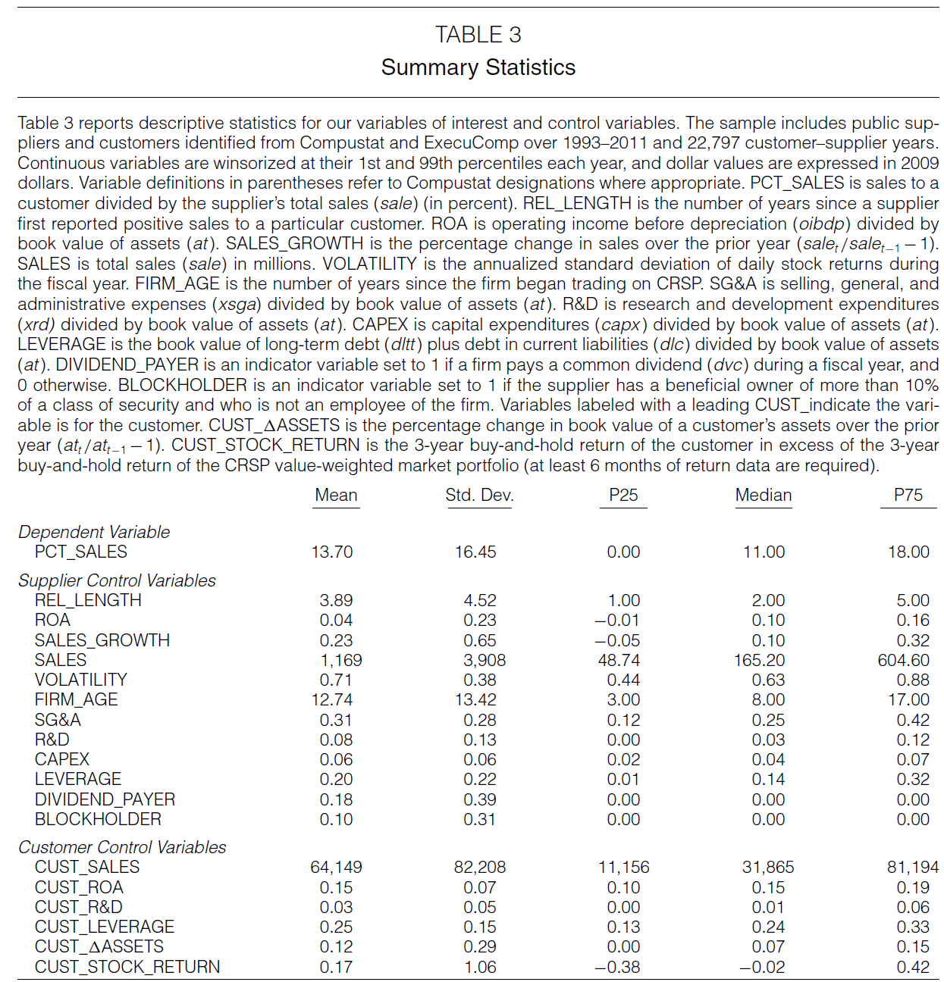

Slide 12
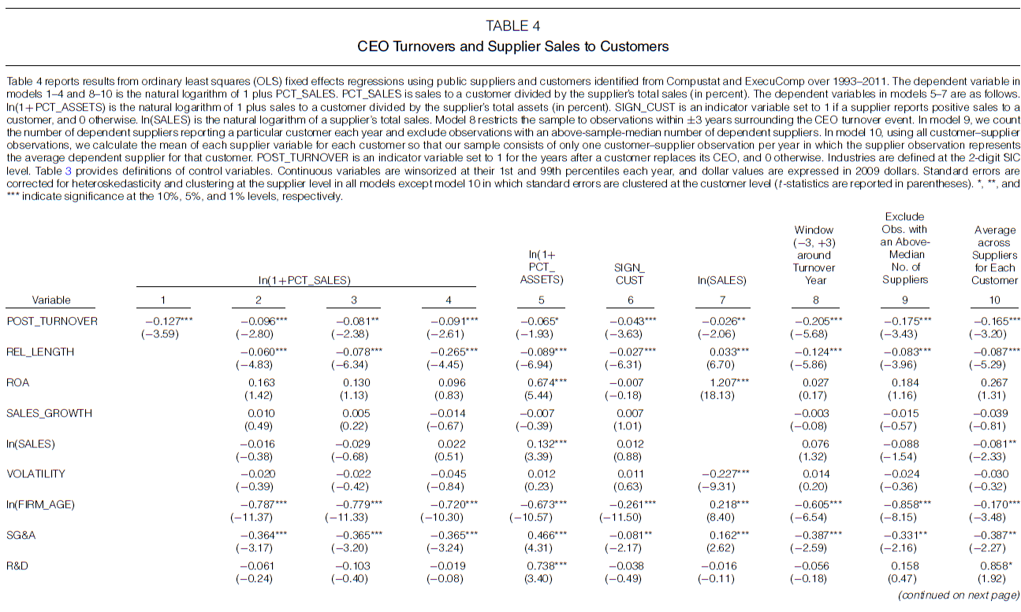
Notes:
Model 1 includes only the variable POST_TURNOVER along with year and customer–supplier fixed effects and shows that sales to a customer as a fraction of supplier total sales decrease by 12.7 log points (11.9%) following the replacement of the customer’s CEO.
Model 2 adds controls for supplier characteristics.
Model 3 adds controls for customer characteristics.
Model 4 adds industry-year fixed effects.
Models 5–7 use alternative specifications of the dependent variable.
Model 8 restricts the sample to the +/- 3 years surrounding turnover.
Model 9 excludes observations with an above sample median number of suppliers.
Model 10 uses the average across suppliers for each customer.

Slide 13
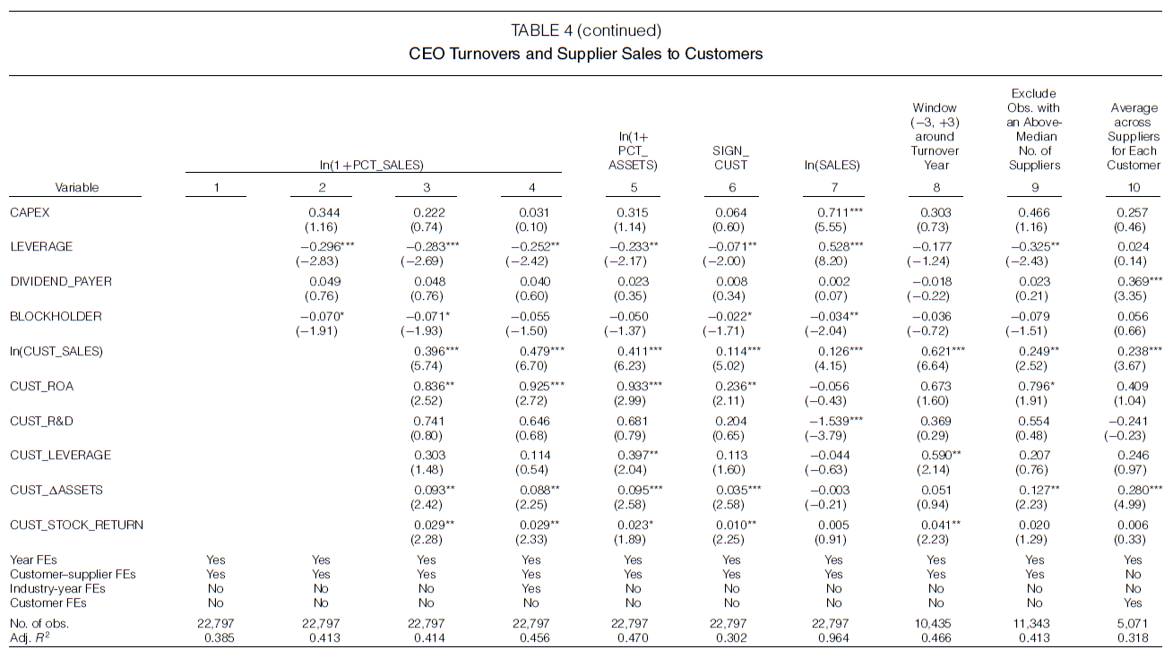

Slide 14
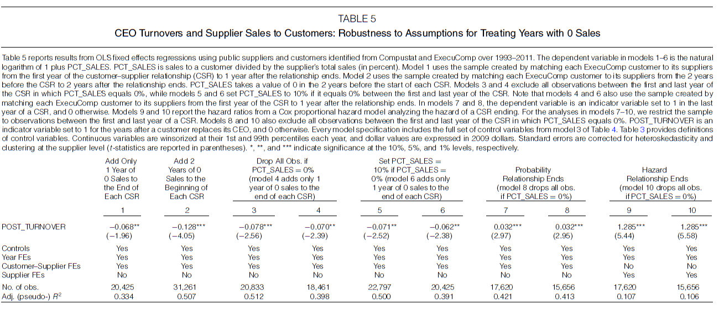
Notes:
Models 1 and 2 show the extent to which the selected approach to matching customer–supplier relationships influences the findings.
Models 3–6 test the sensitivity of the findings to different treatments of years when sales to a customer are missing between the first and last year of the relationship.
Models 7 and 8 model the probability that the relationship ends.
Models 9 and 10 use Cox proportional hazard models.

Slide 15
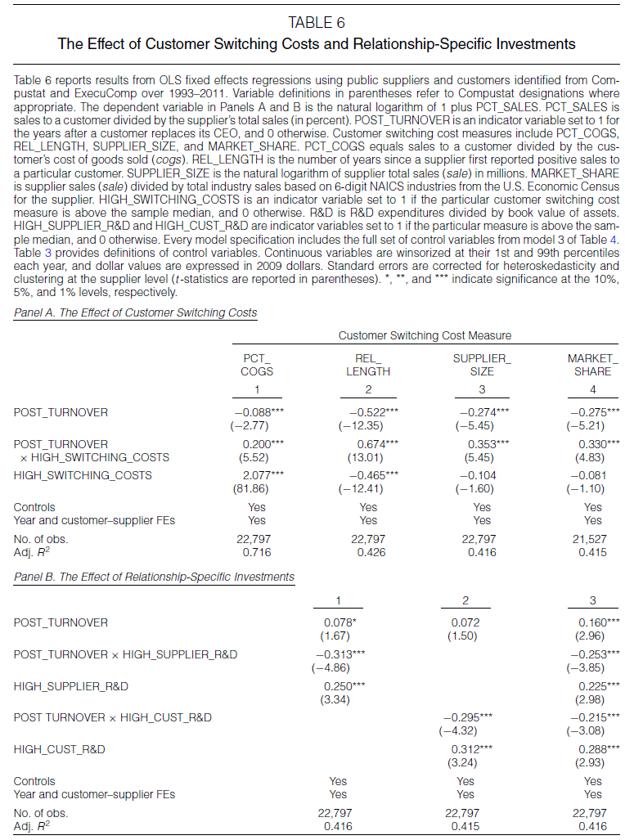
Notes:
Panel A: The interaction terms in each model imply that suppliers benefit from customer CEO turnovers when customers have greater switching costs.
Panel B: Customer CEO turnovers benefit suppliers that are less likely to have made RSIs but hurt those that are more likely to have made RSIs.

Slide 16
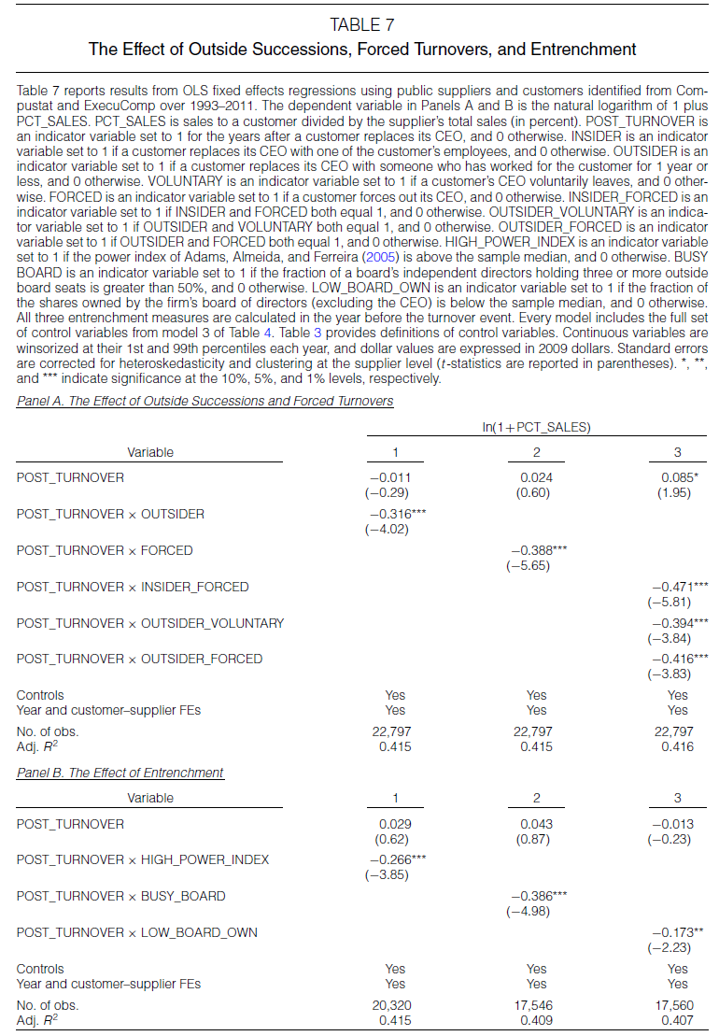
Notes:
Panel A: The results show that, except when incumbent CEOs leave voluntarily and are replaced by insiders, sales to customers significantly decline following CEO turnovers.
Panel B: The negative relation is more pronounced incumbent is more likely to have greater decision-making power over the board and weaker board oversight.

Slide 17
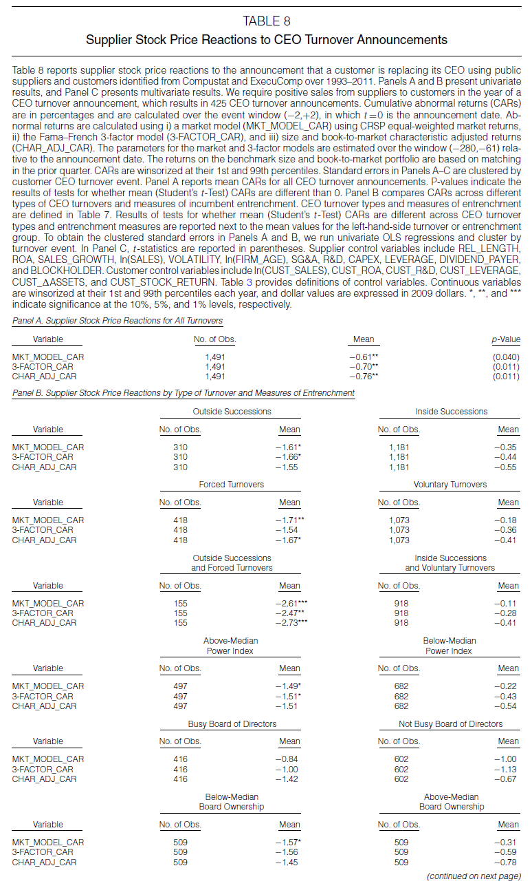
Notes:
Panel A: Over the 5-day window around the turnover announcement date and across our three measures of abnormal returns, suppliers experience negative and statistically significant abnormal returns.

Slide 18
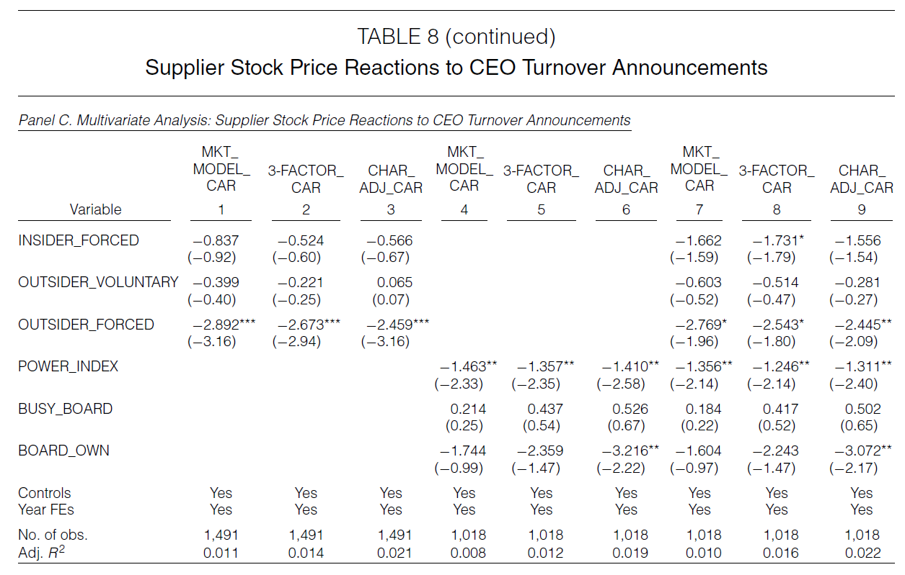
Notes:
Models 1–3 show that CARs to announcements of outside successions following forced turnovers are significantly more negative than CARs to announcements of inside successions following voluntary turnovers.
Models 4–6 show a negative relation between supplier CARs and the incumbent’s power index.
Models 7–9 include both turnover types and entrenchment measures in the same model and confirm the previous results.

Slide 19
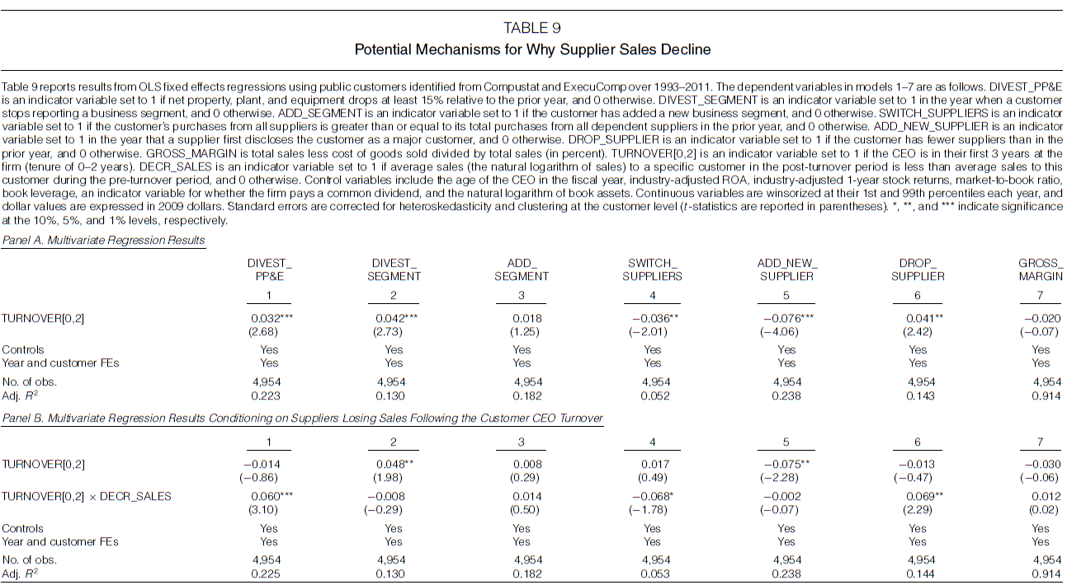
Notes:
Models 1–3 show that new CEOs are significantly more likely to divest PP&E and business segments.

Slide 20
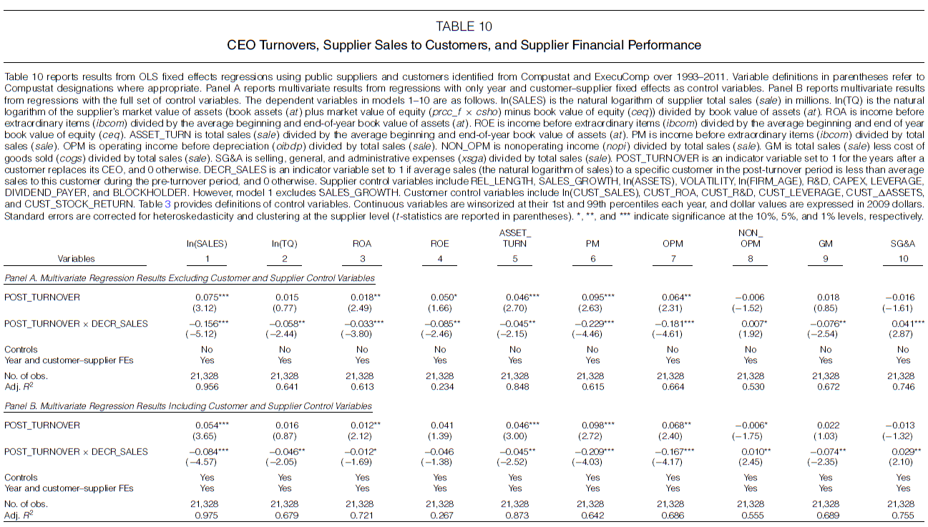
Notes:
A decline in supplier sales to a customer that replaces its CEO leads to lower overall supplier financial performance.

Slide 21
Conclusion
Replacement of a customer’s CEO significantly disrupts its relationships with dependent suppliers.
Dependent suppliers experience a significant decline in sales to customers that replace their CEOs.
Supplier firm value and operating performance deteriorate following CEO turnovers.
Supplier shareholders react negatively to the announcement of a customer CEO departure.

